Slide 1
College E-rollment System
CST499 Final Project Presentation by Michael Wong
Notes:
Today I will be presenting my final project, which is a College E-Enrollment System. This project shows the full software development lifecycle, including requirements, design, implementation, and testing.

Slide 2
Project Overview
This is a web-based course enrollment system that allows users to:
Register accounts
Log in securely
View courses
Enroll and manage schedules
Notes:
This system is designed to allow students to manage their course enrollment online. It includes core features such as user registration, login authentication, viewing available courses, enrolling in courses, and managing schedules.

Slide 3
SRS Overview
The SRS defines system requirements
Includes:
Functional requirements
Non-functional requirements
Uses “The system shall…” format
Notes:
The Software Requirements Specification, or SRS, defines what the system is supposed to do. It includes both functional requirements, such as user registration and enrollment, and non-functional requirements, such as performance and security.

Slide 4
Key SRS Features
User registration and login
Course listing by semester
Enrollment with capacity limits
Waitlist functionality
Notes:
Some of the key features defined in the SRS include user registration and login, viewing courses by semester, enrolling in courses with capacity limits, and waitlist management when courses are full.

Slide 5
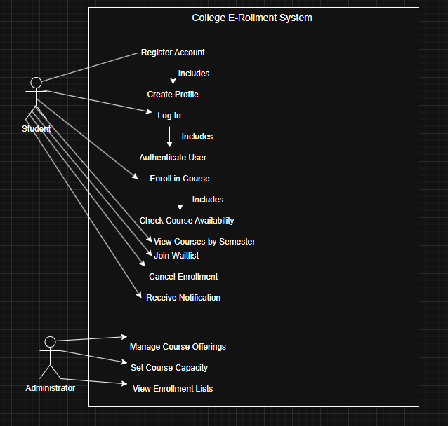
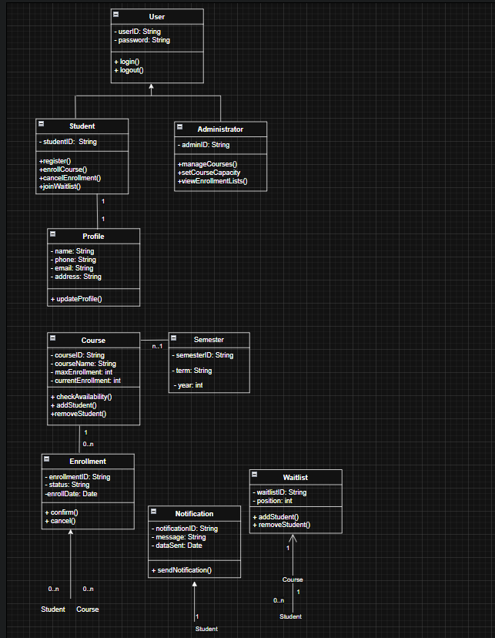
UML Design Overview
The visual representation of system design
Includes:
Use Case Diagram
Class Diagram
Sequence Diagram
Activity Diagram
State Diagram
Notes:
The UML design model provides a visual representation of the system. Each diagram assists in describing different aspects of the system, including structure and behavior. Two examples that we have here are the Class Diagram (shows relationships, classes, attributes) and the use case diagram (how users or actors interact with the system)

Slide 6
UML Highlights
Use Case → user interactions
Class → system structure
Sequence → workflow of actions
Activity → process flow
State → system states
Notes:
The use case diagram shows how users interact with the system. The class diagram defines the structure of the system. The sequence diagram shows how processes occur step by step. Activity and state diagrams show flow and system behavior.

Slide 7
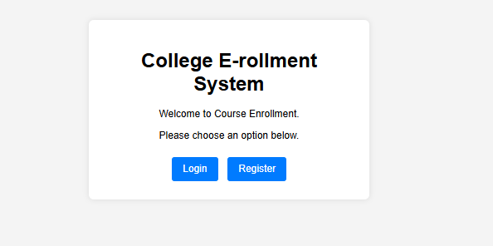
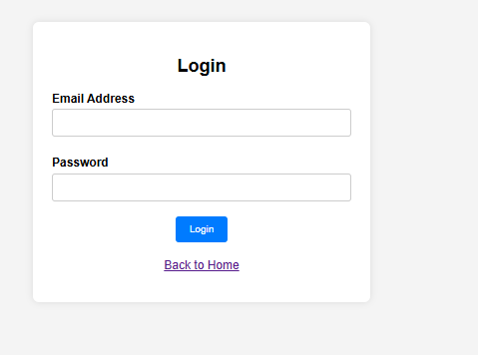
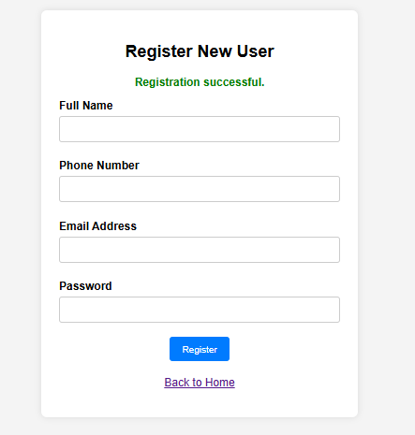
Frontend Design
Landing page
Login page
Registration page
Dashboard
Notes:
The frontend includes several pages. The landing page is the entry point. The login and registration pages allow users to access the system. The dashboard provides navigation to features like course enrollment and schedule viewing.

Slide 8
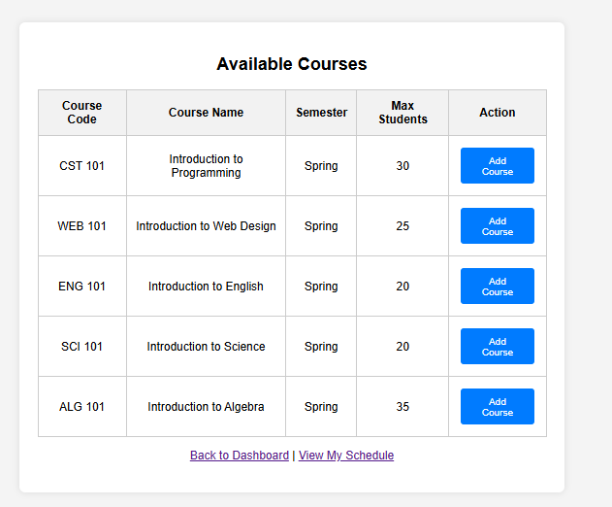
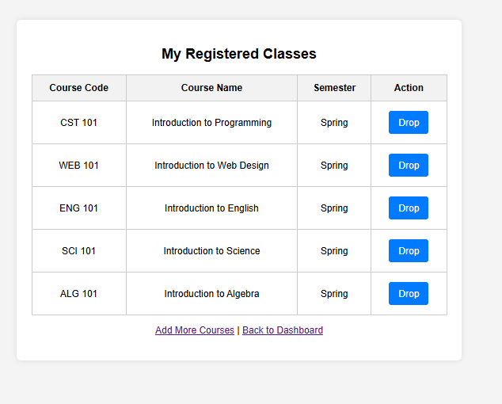
Enrollment Pages
View available courses
Add courses
Prevent duplicate enrollment
Drop courses
View schedule
Notes:
The enrollment pages allow users to view available courses, add courses to their schedule, prevent duplicate enrollments, drop courses, and view their current schedule.

Slide 9
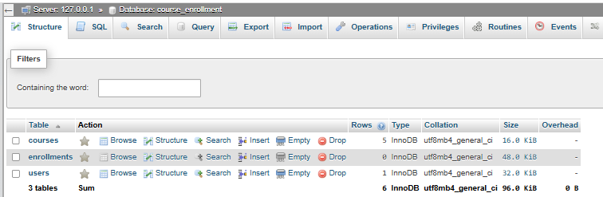
MySQL Database Design
Database: course_enrollment
Tables:
users
courses
enrollments
Notes:
The system uses a MySQL database named course_enrollment. It contains three main tables: users, courses, and enrollments. These tables store all system data and maintain relationships between users and courses.

Slide 10
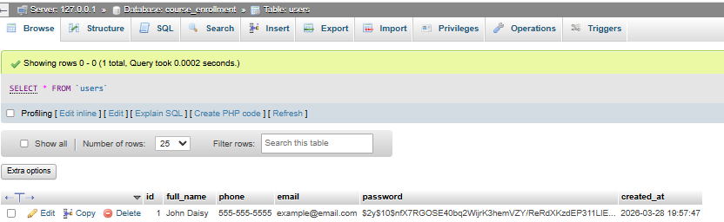
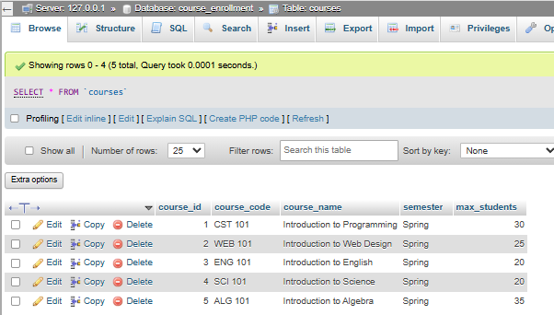
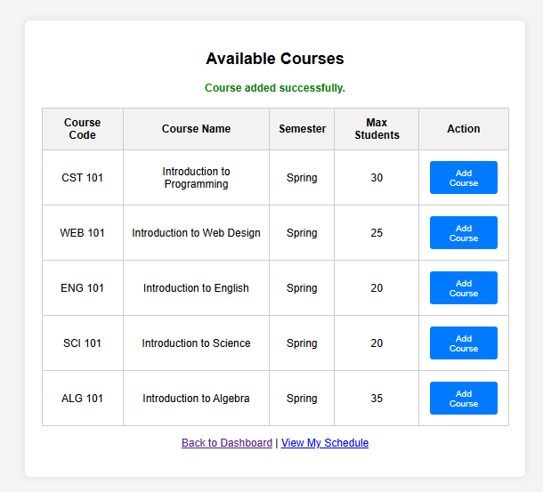
Database Functionality
Stores user data securely
Tracks course capacity
Links users to courses
Supports add/drop functionality
Notes:
The The database stores user information securely and tracks course enrollment. It ensures that course capacity is enforced and links users to their selected courses. It also supports adding and dropping classes.

Slide 11
PHP Code Implementation
This will handle the backend logic.
Features:
User authentication
Database connection
Enrollment validation
Session management
Notes:
PHP is used for backend development. It handles user authentication, database connections, enrollment validation, and session management. It ensures that users can interact with the system securely and efficiently.

Slide 12
Conclusion
Full SDLC implemented
Functional web application created
Integrated frontend, backend, and database
Demonstrates real-world system development
Notes:
In conclusion, this project demonstrates the full software development lifecycle. It integrates frontend design, backend logic, and database management into a functional web application. This project reflects real-world system development practices.

Slide 13
References
Bomström, H., et al. (2023, October). Information needs and presentation in agile software development. ScienceDirect. https://doi.org/10.1016/j.infsof.2023.107265
Tsui, F., Karam, O., & Bernal, B. (2018). Essentials of software engineering (4th ed.). Jones & Bartlett Learning.

